Slide 1
Plagiarism Checker
By: Krishna Rudraraju
Samson Yerraguntla
Sirivarma Vegiraju

Slide 2
Tool Introduction:
Web based tool
Technologies used:
Front End:
Bootstrap 8.0
Jquery 1.9.1
Back End :
Python 2.7
Flask Framework

Slide 3
Tool Architecture:
Client: Browser
Ajax Calls
Flask App on Webserver
Middleware
string_algos
REST/HTTP
JSON Object
JSON Object
uploads

Slide 4
Architecture:
The web page communicates with back end using AJAX calls.
All the string matching algorithms are found in String_Algos package.
As we select the required algorithm, a respective object is created and the algorithm is called.
All the unnecessary data is filtered by middleware
Uploads folder contains the input string files that are fed as input to the string matching algorithms.

Slide 5
Tool Features:
User can upload the desired input string and pattern files.
User can also run the algorithm for individual Strings of Files.
The tool provides the following four algorithms and privides a time analysis of the respective algorithms.
LCSS
KMP
Boyer Moore Algorithm
Naïve String Search
We can also do the time analysis of the same input on all the algorithms at once.
Time analysis is done by generating the time graph of algorithms.

Slide 6
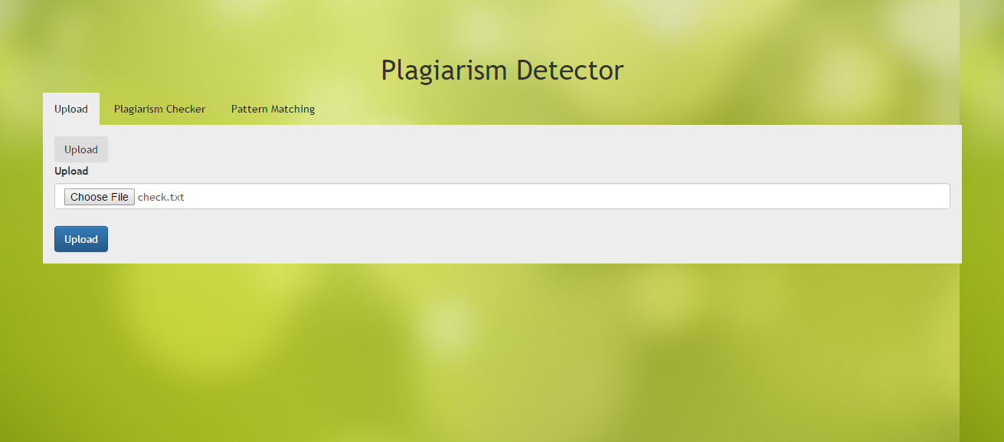
Uploading input files for the string matching algorithms:

Slide 7
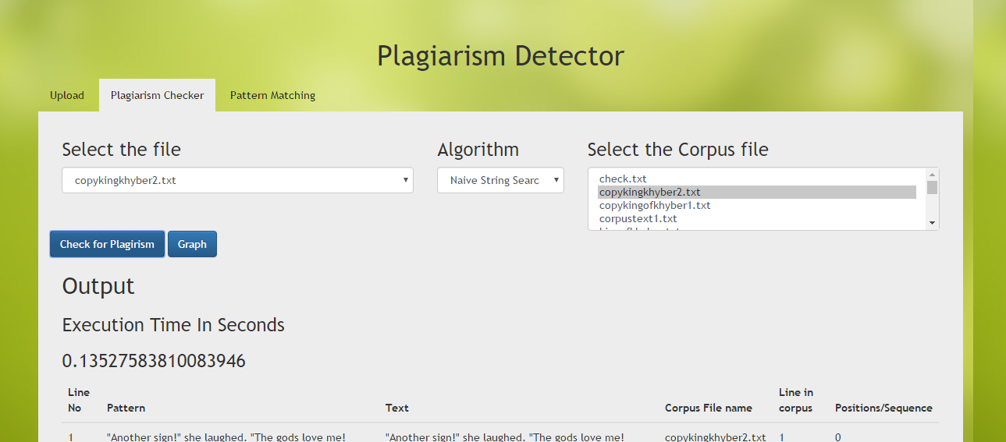
String matching when the inputs are text files:

Slide 8
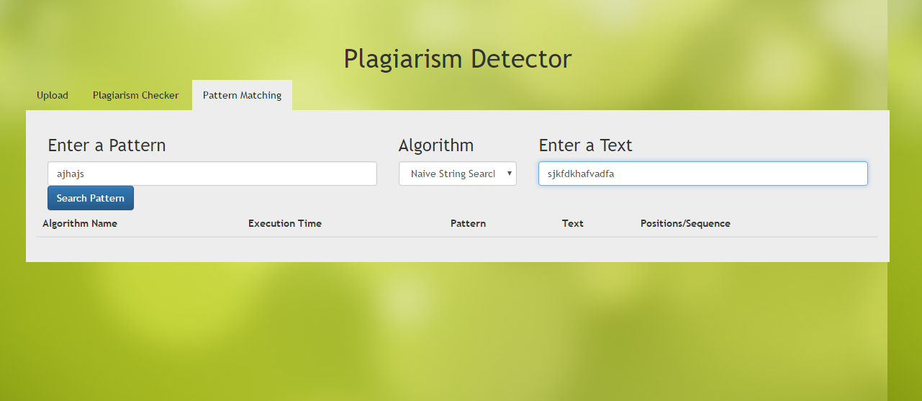
String matching when the input is an individual string:

Slide 9
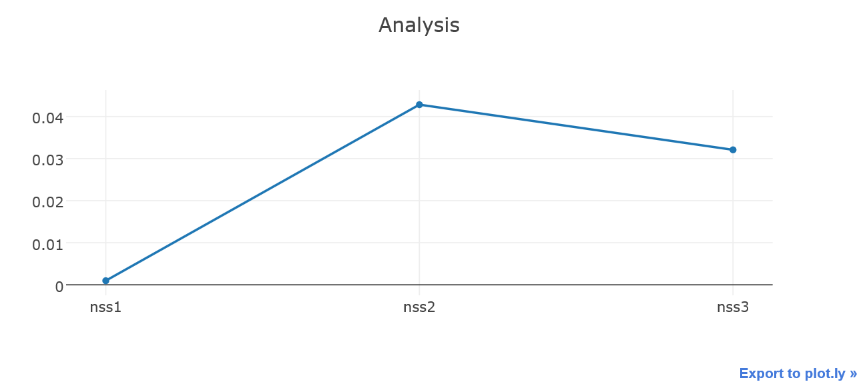
Time Analysis Graph when Naïve String Search algorithm is run:

Slide 10
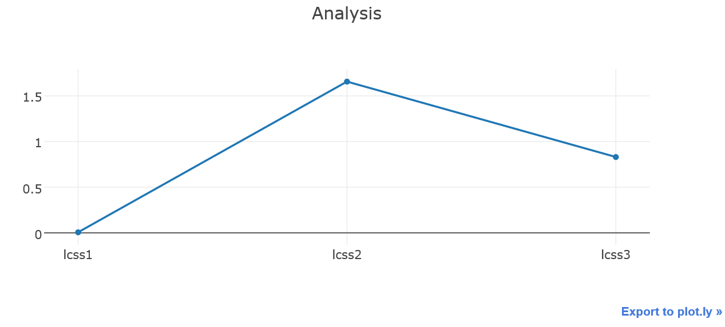
Time Analysis Graph when LCSS algorithm is run:

Slide 11
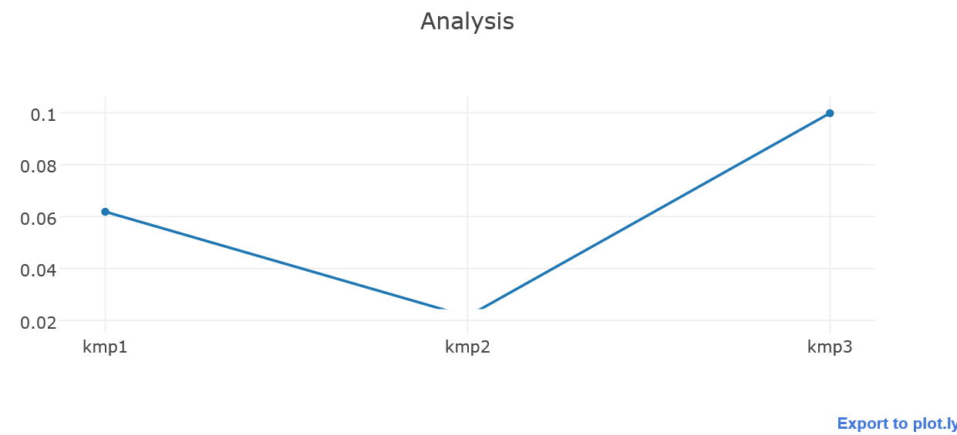
Time Analysis Graph when KMP algorithm is run:

Slide 12
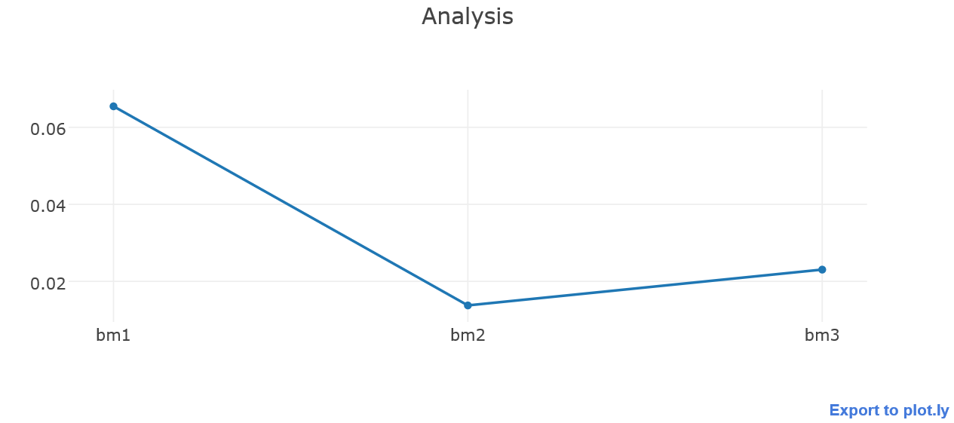
Time Analysis Graph when Booyer Moore algorithm is run:

Slide 13
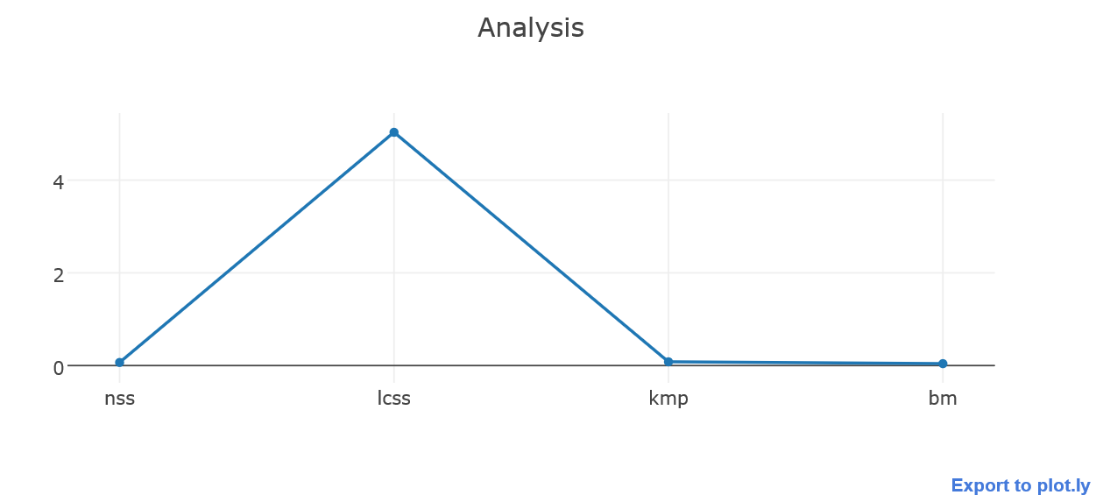
Time Analysis Graph when all algorithms are run:

Slide 14
Contributions:
Activities
Boyer Moore | Samson Y
KMP | Krishna R
Naïve String Search and LCSS | Sirivarma V
Front end calls, REST calls | Samson Y, Krishna R
Middleware | Samson Y, Sirivarma V
Performance analysis of Strings | Sirivarma V, Krishna R
Performance analysis of files | Sirivarma V, Samson Y
Presentation | Sirivarma V, Samson Y, Krishna R

Slide 15
Thank You

